Slide 1
COMP9414 Tutorial
Week 10 (Final week)

Slide 2

News
Assignment 2 marking will begin soon
Expect to see marks possibly next week
Exam consultations on:
2pm Tuesday (August 11th)
2pm Thursday (August 13th)
2pm Monday (August 17th)
Exam is at 2 - 5pm Tuesday (August 18th)
2 hours and 10 mins in length, must complete by 5pm
Make sure you do the practise exam to test your network

Slide 3
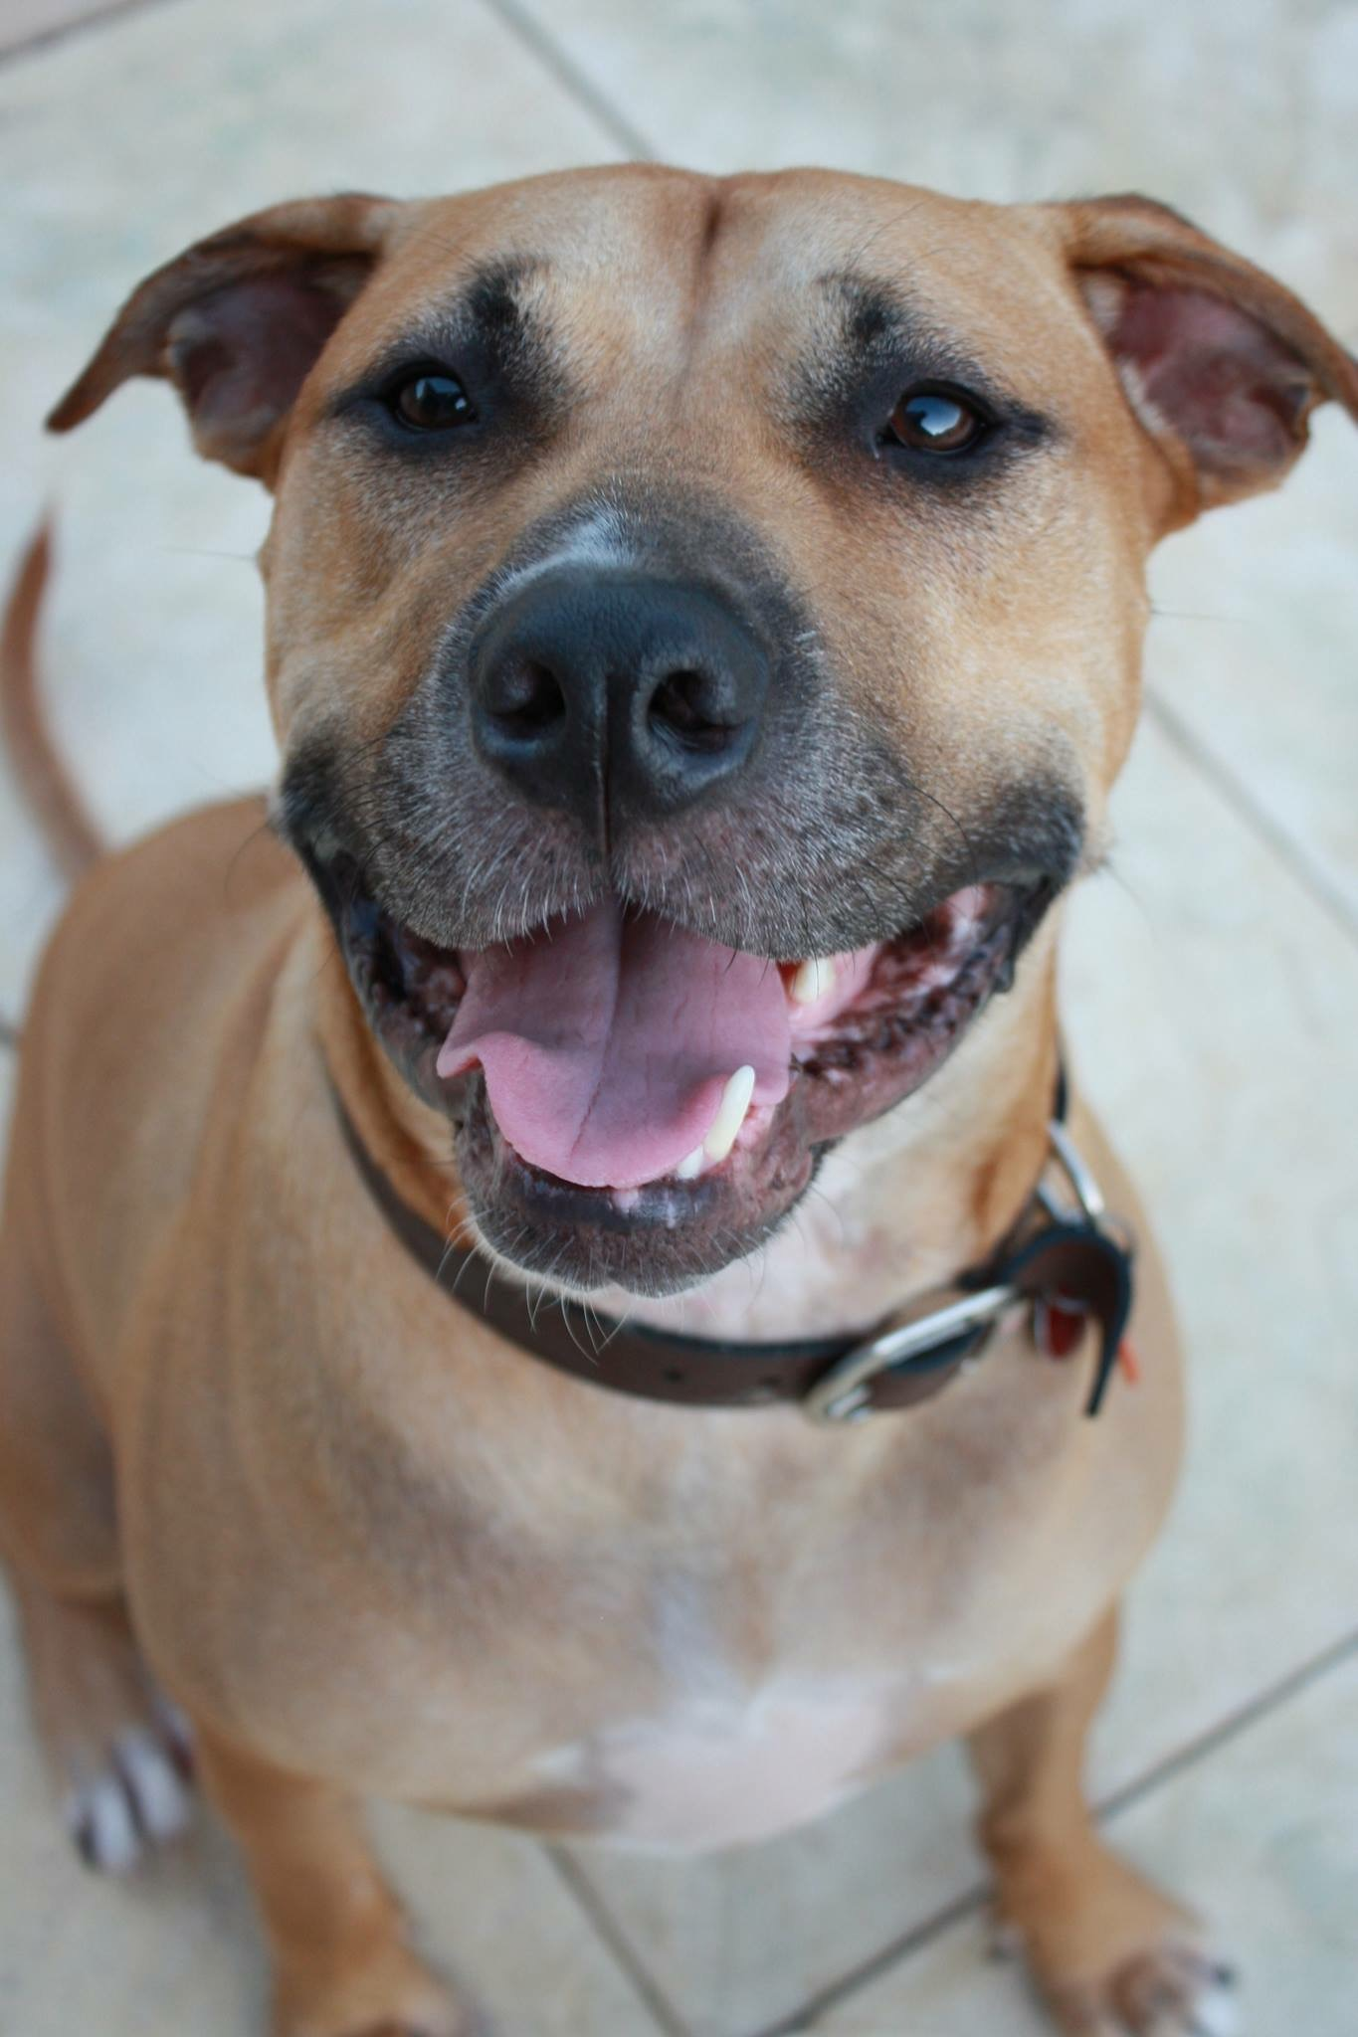



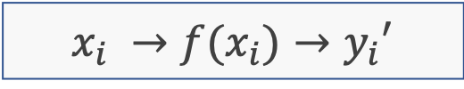



Supervised Learning
Train an algorithm to learn a mapping function between a set of input and output
$\left(x_{0},y_{0}\right),\left(x_{1},y_{1}\right)…$ $(x_{n},y_{n})$
$$x_{i} →f(x_{i})→y_{i}′$$
$$y_{i}′≅y$$
$$Dog$$
$$Cat$$
$$Rabbit$$
Supervised Learner

Slide 4
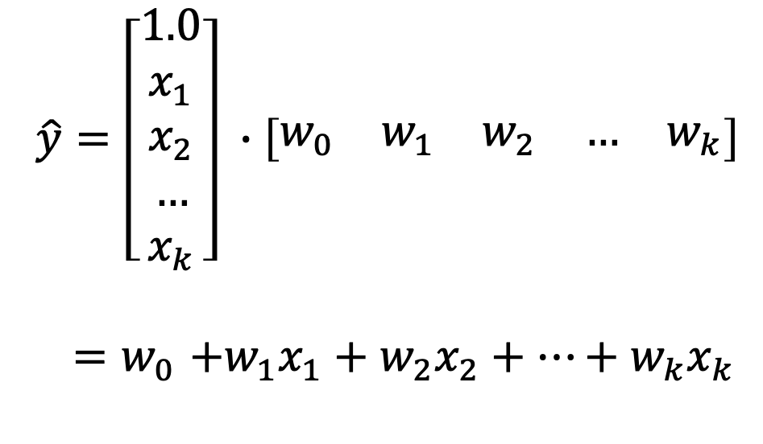

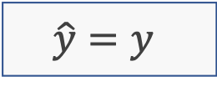
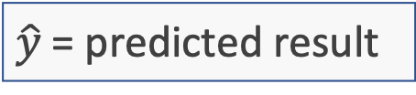
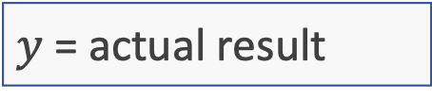
Perceptrons
$$\hat{y}=\left[\begin{matrix}1.0 \\ x_{1} \\ x_{2} \\ … \\ x_{k}\end{matrix}\right] ∙\left[\begin{matrix}w_{0} & w_{1} & w_{2} & … & w_{k}\end{matrix}\right]$$
${=w}_{0}+w_{1}x_{1}+w_{2}x_{2}+…+w_{k}x_{k}$
x = input matrix
w = weight matrix
$y$ = actual result
$\hat{y}$= predicted result
Generate a weight matrix that ensures:
$$\hat{y}=y$$
$$w_{0}≡b$$

Slide 5
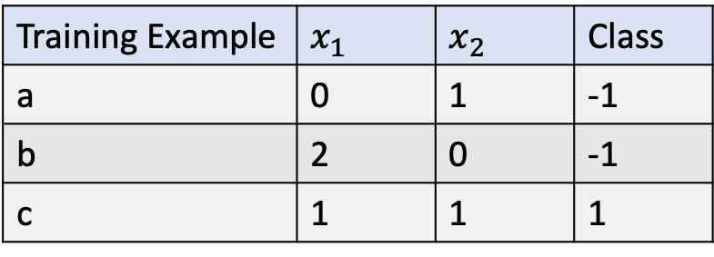
Question 1a
Training Example | $$x_{1}$$ | $$x_{2}$$ | Class
a | 0 | 1 | -1
b | 2 | 0 | -1
c | 1 | 1 | 1
1, 1
Class: +1
0, 1
Class: -1
2, 0

Slide 6
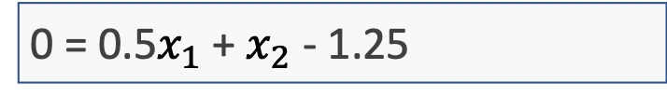
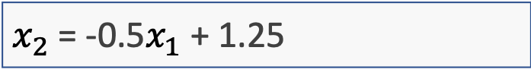
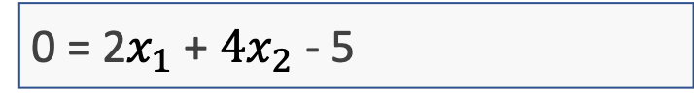
Question 1a
Slope = m = 0 – 1 / 2 – 0 = -1/2
y = mx + b
1 = -1/2 * 0.5 + b
b = 1.25 = 5/4
1, 1
Class: +1
0, 1
$x_{2}$ = -0.5$x_{1}$ + 1.25
0 = 0.5$x_{1}$ + $x_{2}$ - 1.25
Class: -1
0 = 2$x_{1}$ + ${4x}_{2}$ - 5
2, 0

Slide 7
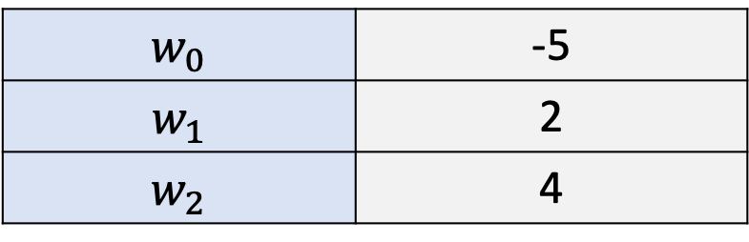

Question 1a
Training Example | $$x_{1}$$ | $$x_{2}$$ | Class
a | 0 | 1 | -1
b | 2 | 0 | -1
c | 1 | 1 | 1
1, 1
Class: +1
0 = 2$x_{1}$ + ${4x}_{2}$ - 5
$$w_{0}$$ | -5
$$w_{1}$$ | 2
$$w_{2}$$ | 4
0, 1
Class: -1
2, 0

Slide 8
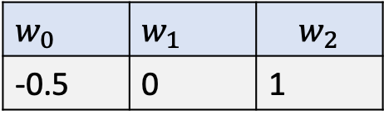
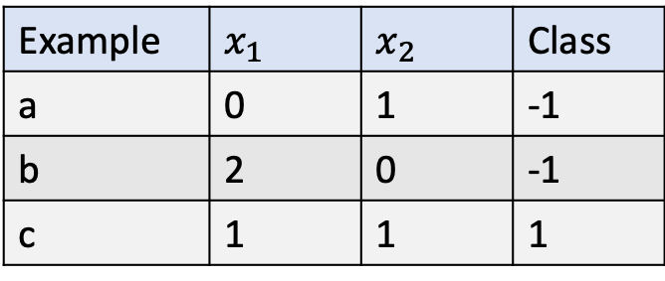
Question 1b Perceptron Learning Algorithm
1
Calculate $s$ (prediction)
2
Execute transfer function
3
Compare prediction with actual class
4
Change weights if necessary
Example | $$x_{1}$$ | $$x_{2}$$ | Class
a | 0 | 1 | -1
b | 2 | 0 | -1
c | 1 | 1 | 1
$$w_{0}$$ | $$w_{1}$$ | $$w_{2}$$
-0.5 | 0 | 1

Slide 9

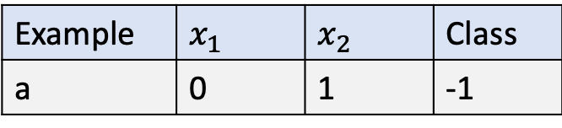




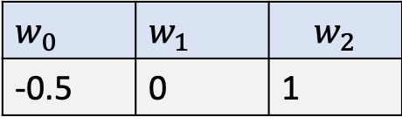

Question 1b Perceptron Learning Algorithm
1
Calculate $s$ (prediction)
$${s=w}_{0}+w_{1}x_{1}+w_{2}x_{2}$$
$$w_{0}$$ | $$w_{1}$$ | $$w_{2}$$
-0.5 | 0 | 1
$$w_{0}$$
-0.5
$$w_{1}x_{1}$$
$$0 ∗0$$
0
Example | $$x_{1}$$ | $$x_{2}$$ | Class
a | 0 | 1 | -1
$$w_{2}x_{2}$$
$$1 ∗1$$
1
$$w_{0}+w_{1}x_{1}+w_{2}x_{2}$$
0.5

Slide 10



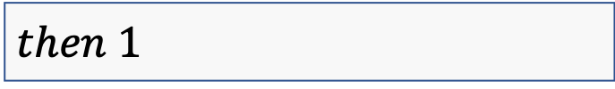




Question 1b Perceptron Learning Algorithm
2
Execute transfer function $g(s)$
$$g(s)$$
$$\{$$
$$w_{0}$$ | $$w_{1}$$ | $$w_{2}$$
-0.5 | 0 | 1
$$if s≥0$$
$$then 1$$
Example | $$x_{1}$$ | $$x_{2}$$ | Class
a | 0 | 1 | -1
$$if s<0$$
$$then 0$$
$$\}$$
$$g(0.5)$$
1

Slide 11





Question 1b Perceptron Learning Algorithm
3
Compare prediction with actual class
$$if g(s)>g(actual_class)$$
$$w_{0}$$ | $$w_{1}$$ | $$w_{2}$$
-0.5 | 0 | 1
$$Subtraction$$
-
$$if g(s)<g(actual_class)$$
Example | $$x_{1}$$ | $$x_{2}$$ | Class
a | 0 | 1 | -1
$$Addition$$
+
$$if 1>0$$
-

Slide 12

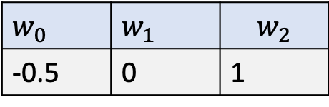

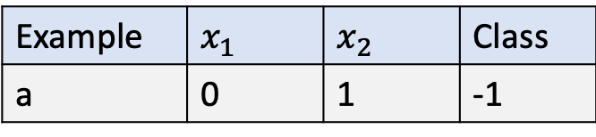

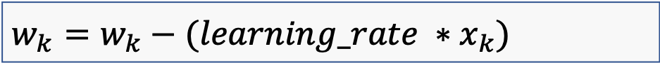
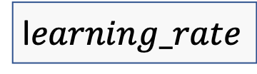


Question 1b Perceptron Learning Algorithm
4
Change weights if necessary
$$Addition$$
$$w_{0}$$ | $$w_{1}$$ | $$w_{2}$$
-0.5 | 0 | 1
$$w_{0}=w_{0}+learning_rate$$
$$w_{k}=w_{k}+(learning_rate ∗x_{k})$$
Example | $$x_{1}$$ | $$x_{2}$$ | Class
a | 0 | 1 | -1
$$Subtraction$$
$$w_{0}=w_{0}−learning_rate$$
$$w_{k}=w_{k}−(learning_rate ∗x_{k})$$
l$earning_rate$
1

Slide 13






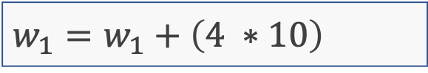




Question 1b - Learning Rate
Control the degree that the weights can be changed
Larger learning rate results in big changes
Converges to the optimal solution faster, but risks moving past or losing it
$$s=w_{0}+{w_{0}x}_{1}=1+5∗10=51$$
$$\hat{y}=51, y=55$$
$$\hat{y} ≢y$$
$$Addition$$
$$w_{0}=1$$
$$w_{1}=5$$
$$w_{0}=w_{0}+4$$
5
Completely missed the predicted value.
$$x_{1}=10$$
$$w_{1}=w_{1}+\left(4 ∗10\right)$$
45
$$Learning_rate=4$$
$$s=5+45∗10=5+450=455$$

Slide 14






Question 1b - Learning Rate
Smaller learning rate results in shorter, more precise steps
Converges to the optimal solution much slower, but can get closer since the steps are miniscule
$$s=w_{0}+{w_{0}x}_{1}=1+5∗10=51$$
$$\hat{y}=51, y=55$$
$$\hat{y} ≢y$$
$$Addition$$
$$w_{0}=1$$
$$w_{1}=5$$
$$w_{0}=w_{0}+0.005$$
1.005
Step is too small, will take too long to converge.
$$x_{1}=10$$
$$w_{1}=w_{1}+\left(0.005 ∗10\right)$$
5.05
$$Learning_rate=0.005$$
$$s=1.005+5.05∗10=1.005+50.5=51.505$$

Slide 15

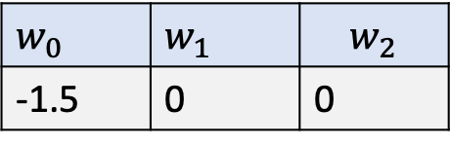
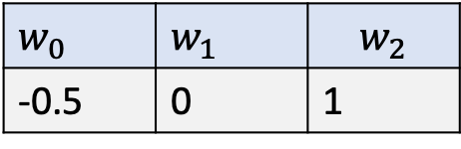










Question 1b Perceptron Learning Algorithm
4
Change weights if necessary
Example | $$x_{1}$$ | $$x_{2}$$ | Class
a | 0 | 1 | -1
$$Subtraction$$
$$w_{0}=w_{0}−learning_rate$$
$$w_{0}=−0.5−1$$
$$−1.5$$
$$w_{k}=w_{k}−(learning_rate ∗x_{k})$$
$$w_{1}=0−(1∗0)$$
$$0$$
$$w_{2}=1−(1∗1)$$
$$0$$
$$w_{0}$$ | $$w_{1}$$ | $$w_{2}$$
-0.5 | 0 | 1
$$→$$
$$w_{0}$$ | $$w_{1}$$ | $$w_{2}$$
-1.5 | 0 | 0

Slide 16

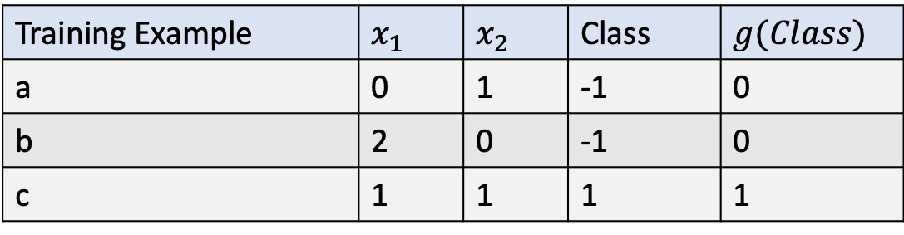


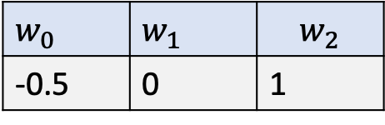
Question 1b
Training Example | $$x_{1}$$ | $$x_{2}$$ | Class | $$g(Class)$$
a | 0 | 1 | -1 | 0
b | 2 | 0 | -1 | 0
c | 1 | 1 | 1 | 1
$$w_{0}$$ | $$w_{1}$$ | $$w_{2}$$
-0.5 | 0 | 1
Iteration 1
a
Prediction
+ 0.5
$$g(0.5) = 1$$
Subtraction
$$w_{0}=−0.5−1.0$$
$$−1.5$$
$w_{1}=0.0−(1.0 × 0.0)$
$$0.0$$
$w_{2}=1.0−(1.0 × 1.0)$
$$0.0$$

Slide 17

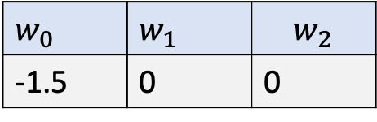
Question 1b
Training Example | $$x_{1}$$ | $$x_{2}$$ | Class | $$g(Class)$$
a | 0 | 1 | -1 | 0
b | 2 | 0 | -1 | 0
c | 1 | 1 | 1 | 1
$$w_{0}$$ | $$w_{1}$$ | $$w_{2}$$
-1.5 | 0 | 0
Iteration 2
b
Prediction
- 0.5
$$g(−0.5) =0$$
Subtraction
Do nothing since the predicted result matches the positivity of the actual result

Slide 18



Question 1b
Training Example | $$x_{1}$$ | $$x_{2}$$ | Class | $$g(Class)$$
a | 0 | 1 | -1 | 0
b | 2 | 0 | -1 | 0
c | 1 | 1 | 1 | 1
$$w_{0}$$ | $$w_{1}$$ | $$w_{2}$$
-1.5 | 0 | 0
Iteration 3
c
Prediction
- 1.5
$$g(−1.5) =0$$
Subtraction
$w_{0}=−1.5+1.0$
$$−0.5$$
$w_{1}=0.0+(1.0 × 1.0)$
$$1.0$$
$w_{2}=0.0+(1.0 × 1.0)$
$$1.0$$

Slide 19



Question 1b
Training Example | $$x_{1}$$ | $$x_{2}$$ | Class | $$g(Class)$$
a | 0 | 1 | -1 | 0
b | 2 | 0 | -1 | 0
c | 1 | 1 | 1 | 1
$$w_{0}$$ | $$w_{1}$$ | $$w_{2}$$
-3.5 | 0 | 1
Iteration 21
c
Prediction
- 1.5
$$g(−1.5) =0$$
Subtraction
$w_{0}=−3.5+(1.0 × 1.0)$
$$−2.5$$
$w_{1}=0.0+(1.0 × 1.0)$
$$1.0$$
$w_{2}=1.0+(1.0 × 1.0)$
$$2.0$$

Slide 20
Question 2a
Perceptron to compute the OR function of m inputs
Set the bias weight to -1⁄2, all other weights to 1
m inputs where at least one must be true for the overall function to be true
a ∨ b ∨ c ∨ d ∨ e … ∨ z

Slide 21
Question 2b
Perceptron to compute the AND function of m inputs
Set the bias weight to 1⁄2 - n, all other weights to 1
m inputs where all must be true for the overall function to be true
a ∧ b ∧ c ∧ d ∧ e … ∧ z

Slide 22
Question 2c
2-Layer Neural Network to compute any (given) logical expression, assuming it is written in Conjunctive Normal Form.
Conjunctive normal form is a series of disjunctive predicates connected by conjunctions
(A ∨ B) ∧ (¬B ∨ C ∨ ¬D) ∧ (D ∨ ¬E)

Slide 23
Question 2c
(A ∨ B) ∧ (¬B ∨ C ∨ ¬D) ∧ (D ∨ ¬E)
Weights should be +1 for normal predicates
Weights should be -1 for negations
Basically a combination of the previous two questions

Slide 24




Question 2c
(A ∨ B) ∧ (¬B ∨ C ∨ ¬D) ∧ (D ∨ ¬E)
$$1x_{1}+1x_{2}+1x_{3}+(0.5 −3)$$
Conjunctive bias
Disjunctive bias
A
B
B
C
D
D
E
$$1x_{1}+1x_{2}+(0 −0.5)$$
$$−1x_{1}+1x_{2}−1x_{3}+ (2 −0.5)$$
$$1x_{1}−1x_{2}+ (1 −0.5)$$

Slide 25





Reinforcement Learning
Train an algorithm by providing it rewards when it makes the correct decision
$$Win$$
$$+1$$
$$Loss$$
$$−1$$
Chess Move
Reinforcement Learner

Slide 26
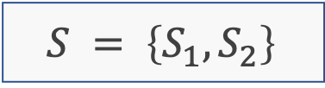
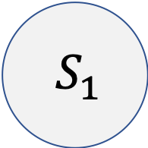
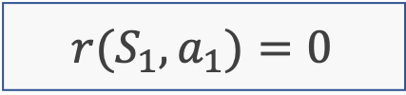
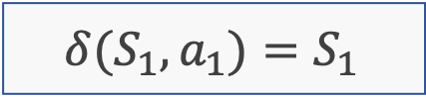


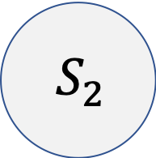
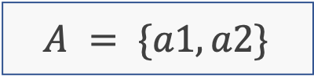
Question 3i
$$S = \left\{S_{1},S_{2}\right\}$$
$A = \{a1,a2\}$
$$δ(S_{1},a_{1})=S_{1}$$
$$r(S_{1},a_{1})=0$$
$$S_{1}$$
$$S_{2}$$
$$0$$
$$a_{1}$$

Slide 27



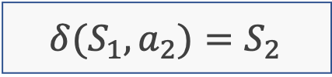
Question 3i
$$S = \left\{S_{1},S_{2}\right\}$$
$A = \{a1,a2\}$
$$δ(S_{1},a_{2})=S_{2}$$
$$r\left(S_{1},a_{2}\right)=−1$$
$$S_{1}$$
$$S_{2}$$
$$0$$
$$a_{1}$$
$$−1$$
$$a_{2}$$

Slide 28

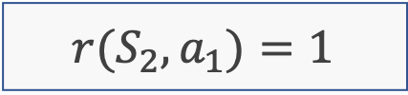
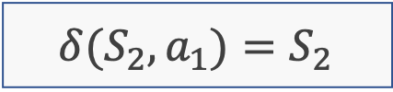

Question 3i
$$S = \left\{S_{1},S_{2}\right\}$$
$A = \{a1,a2\}$
$$δ(S_{2},a_{1})=S_{2}$$
$$r(S_{2},a_{1})=1$$
$$S_{1}$$
$$S_{2}$$
$$0$$
$$a_{1}$$
$$1$$
$$a_{1}$$
$$−1$$
$$a_{2}$$

Slide 29
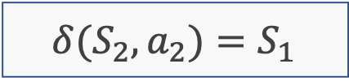

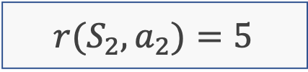
Question 3i
$$S = \left\{S_{1},S_{2}\right\}$$
$A = \{a1,a2\}$
$$δ(S_{2},a_{2})=S_{1}$$
$$r(S_{2},a_{2})=5$$
$$5$$
$$a_{2}$$
$$S_{1}$$
$$S_{2}$$
$$0$$
$$a_{1}$$
$$1$$
$$a_{1}$$
$$−1$$
$$a_{2}$$

Slide 30

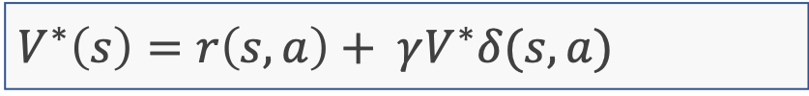










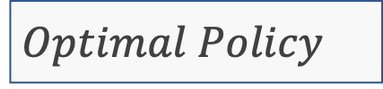
Question 3iib - Calculating the Optimal Policy
Bellman equation
$$5$$
$$a_{2}$$
$$V^{∗}\left(s\right)=r\left(s,a\right)+ γV^{∗}δ(s, a)$$
$$S_{1}$$
$$S_{2}$$
$$0$$
$$a_{1}$$
$$1$$
$$a_{1}$$
$$−1$$
$$a_{2}$$
$$π:S→A$$
$$Optimal Policy$$
Maximises the cumulative reward
1
Calculate bellman equation for each state and action pair
2
Select the pair that achieves the highest combined result
This becomes the optimal policy

Slide 31
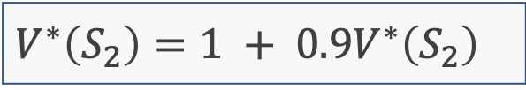







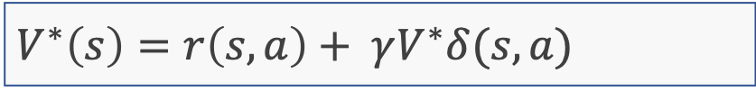


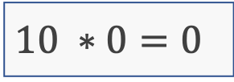

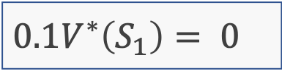



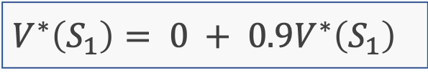


Question 3iib
$$γ=0.9$$
$$V^{∗}\left(s\right)=r\left(s,a\right)+ γV^{∗}δ(s, a)$$
$$δ^{∗}\left(S_{1}\right)=S_{1}$$
$$V^{∗}\left(S_{1}\right)= 0 + 0.9V^{∗}\left(S_{1}\right)$$
$${0.1V}^{∗}\left(S_{1}\right)= 0$$
$$10 ∗0=0$$
$$δ^{∗}\left(S_{2}\right)=S_{2}$$
$$V^{∗}\left(S_{2}\right)=1 + 0.9V^{∗}\left(S_{2}\right)$$
$${0.1V}^{∗}\left(S_{2}\right)=1$$
$$10∗1=10$$
$$V^{∗}\left(S_{1}\right)=0$$
$$5$$
$$a_{2}$$
$$0$$
$$a_{1}$$
$$S_{1}$$
$$S_{2}$$
$$1$$
$$a_{1}$$
$$V^{∗}\left(S_{2}\right)=10$$
$$−1$$
$$a_{2}$$

Slide 32

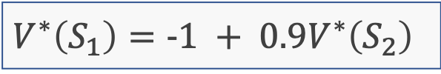





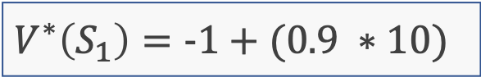

Question 3iib
$$γ=0.9$$
$$V^{∗}\left(s\right)=r\left(s,a\right)+ γV^{∗}δ(s, a)$$
$$δ^{∗}\left(S_{2}\right)=S_{2}$$
$$V^{∗}\left(S_{2}\right)=1 + 0.9V^{∗}\left(S_{2}\right)$$
$${0.1V}^{∗}\left(S_{2}\right)=1$$
$$10∗1=10$$
$$δ^{∗}\left(S_{1}\right)=S_{2}$$
$$V^{∗}\left(S_{1}\right)=−1 + 0.9V^{∗}\left(S_{2}\right)$$
$$V^{∗}\left(S_{1}\right)=−1+(0.9 ∗10)$$
= 8
$$V^{∗}\left(S_{1}\right)=10$$
$$5$$
$$a_{2}$$
$$0$$
$$a_{1}$$
$$S_{1}$$
$$S_{2}$$
$$1$$
$$a_{1}$$
$$V^{∗}\left(S_{2}\right)=8$$
$$−1$$
$$a_{2}$$

Slide 33
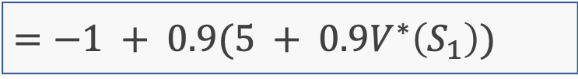

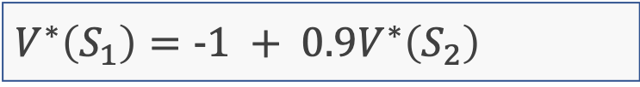








Question 3iib
$$γ=0.9$$
$$V^{∗}\left(s\right)=r\left(s,a\right)+ γV^{∗}δ(s, a)$$
$$δ^{∗}\left(S_{1}\right)=S_{2}$$
$$δ^{∗}\left(S_{2}\right)=S_{1}$$
$$V^{∗}\left(S_{2}\right)=5 + 0.9V^{∗}\left(S_{1}\right)$$
$$V^{∗}\left(S_{1}\right)=−1 + 0.9V^{∗}\left(S_{2}\right)$$
$$=−1 + 0.9(5 + 0.9V^{∗}\left(S_{1}\right))$$
$$≅r\left(S_{1},a_{2}\right)+ γ( γV^{∗}δ\left(S_{1}, a_{2}\right) )$$
$$=−1 +4.5+ {0.9}^{2}V^{∗}\left(S_{1}\right)$$
$$=3.5+ {0.9}^{2}V^{∗}\left(S_{1}\right)$$
$$3.5+0.81V^{∗}\left(S_{1}\right)$$
$${0.19V}^{∗}\left(S_{1}\right)=3.5$$
$$5$$
$$a_{2}$$
$$0$$
$$a_{1}$$
$$S_{1}$$
$$S_{2}$$
$$1$$
$$a_{1}$$
$$V^{∗}\left(S_{1}\right)=3.5/0.19=18.42$$
$$−1$$
$$a_{2}$$

Slide 34








Question 3iib
$$γ=0.9$$
$$V^{∗}\left(s\right)=r\left(s,a\right)+ γV^{∗}δ(s, a)$$
$$δ^{∗}\left(S_{2}\right)=S_{1}$$
$$V^{∗}\left(S_{1}\right)=18.42$$
$$V^{∗}\left(S_{2}\right)=5 + 0.9V^{∗}\left(S_{1}\right)$$
$$=5 + 0.9∗18.42$$
$$=5 +16.58$$
$V^{∗}\left(S_{2}\right)=$ 21.58
$$V^{∗}\left(S_{1}\right)=18.42$$
$$5$$
$$a_{2}$$
$$0$$
$$a_{1}$$
$$S_{1}$$
$$S_{2}$$
$$1$$
$$a_{1}$$
$$V^{∗}\left(S_{2}\right)=21.58$$
$$−1$$
$$a_{2}$$

Slide 35














Question 3iic
$$r\left(s,a\right)+ γV^{∗}δ(s, a)$$
Q$\left(S_{1}, a_{1}\right)$
$$0+γV^{∗}(S_{1})$$
$$16.58$$
$$\text{Q}\left(S_{1}, a_{2}\right)$$
$$V^{∗}(S_{1})$$
$$18.42$$
Q$\left(S_{2}, a_{1}\right)$
$$1+ γV^{∗}(S_{1})$$
$$20.42$$
$$\text{Q}\left(S_{2}, a_{2}\right)$$
$$V^{∗}(S_{1})$$
$$21.58$$
Note
Don’t need Gamma symbol since we already used it in the $a_{2}$ calculations for question 3iib.

Slide 36








Question 3iii
Q
$$a_{1}$$
$$a_{2}$$
$$S_{1}$$
$$16.58$$
$$18.42$$
$$S_{2}$$
$$20.42$$
$$21.58$$
Use Q-Learning to learn this optimal policy to progress between states in such a way to achieve the greatest value.

Slide 37





Question 3iv – Q-Learning
Values initially set to 0 or some fixed amount
Q
$$a_{1}$$
$$a_{2}$$
$$S_{1}$$
$$0$$
$$0$$
$$S_{2}$$
$$0$$
$$0$$
Quality learning learns a policy that tell an agent what action it should take given the current state
Aims to maximise the received reward over all successive steps

Slide 38






Question 3iv – Q-Learning
Loop until converge
Select an action $a_{t}$
Update the $Q(S_{t}, a_{t})$value corresponding to it
$Q\left(S_{t}, a_{t}\right)=r\left(S_{t},a_{t}\right)+ γ∗(\max_{0…k} ( Q\left(S_{t+1},a_{k}\right))$
Where $k$ is every possible actions available from the new state
Switch to the new state $S_{t+1}$
Q
$$a_{1}$$
$$a_{2}$$
$$S_{1}$$
$$0$$
$$0$$
$$S_{2}$$
$$0$$
$$0$$

Slide 39













Question 3iv – Q-Learning
Actions are selected using some degree of probability to encourage exploration
Exploration
Select an action with a worse reward to determine if it leads to a potentially better one
Exploitation
Select an action with an already known reward to maximise the current cumulative reward
$$S_{1}$$
$$5$$
$$a_{2}$$
$$S_{1}$$
$$S_{2}$$
Exploration would select $a_{2}$ as the action
$$0$$
$$a_{1}$$
$$1$$
$$a_{1}$$
Exploitation would select $a_{1}$ as the action
$$−1$$
$$a_{2}$$

Slide 40





















Question 3iv – Q-Learning
$$γ=0.9$$
State
Action
Updated Q Value
$$S_{1}$$
$$a_{1}$$
$$r(S_{1},a_{1})+ γ∗max(Q\left(S_{1},a_{1}\right),Q\left(S_{1},a_{2}\right))$$
$$0+0.9∗0$$
$$=0$$
$$5$$
$$a_{2}$$
$$0$$
$$a_{1}$$
$$S_{1}$$
$$S_{2}$$
$$1$$
$$a_{1}$$
Q
$$a_{1}$$
$$a_{2}$$
$$S_{1}$$
$$0$$
$$0$$
$$−1$$
$$a_{2}$$
$$S_{2}$$
$$0$$
$$0$$

Slide 41



Question 3iv – Q-Learning
$$γ=0.9$$
State
Action
Updated Q Value
$$S_{1}$$
$$a_{2}$$
$$r(S_{1},a_{2})+ γ∗max(Q\left(S_{2},a_{1}\right),Q\left(S_{2},a_{2}\right))$$
$$−1+0.9∗0$$
$$=−1$$
$$5$$
$$a_{2}$$
$$0$$
$$a_{1}$$
$$S_{1}$$
$$S_{2}$$
$$1$$
$$a_{1}$$
Q
$$a_{1}$$
$$a_{2}$$
$$S_{1}$$
$$0$$
$$−1$$
$$−1$$
$$a_{2}$$
$$S_{2}$$
$$0$$
$$0$$

Slide 42



Question 3iv – Q-Learning
$$γ=0.9$$
State
Action
Updated Q Value
$$S_{2}$$
$$a_{1}$$
$$r(S_{2},a_{1})+ γ∗max(Q\left(S_{2},a_{1}\right),Q\left(S_{2},a_{2}\right))$$
$$1+0.9∗0$$
$$=1$$
$$5$$
$$a_{2}$$
$$0$$
$$a_{1}$$
$$S_{1}$$
$$S_{2}$$
$$1$$
$$a_{1}$$
Q
$$a_{1}$$
$$a_{2}$$
$$S_{1}$$
$$0$$
$$−1$$
$$−1$$
$$a_{2}$$
$$S_{2}$$
$$1$$
$$0$$

Slide 43


Question 3iv – Q-Learning
$$γ=0.9$$
State
Action
Updated Q Value
$$S_{2}$$
$$a_{2}$$
$$r(S_{2},a_{2})+ γ∗max(Q\left(S_{1},a_{1}\right),Q\left(S_{1},a_{2}\right))$$
$$5+0.9∗0$$
$$=5$$
$$5$$
$$a_{2}$$
$$0$$
$$a_{1}$$
$$S_{1}$$
$$S_{2}$$
$$1$$
$$a_{1}$$
Q
$$a_{1}$$
$$a_{2}$$
$$S_{1}$$
$$0$$
$$−1$$
$$−1$$
$$a_{2}$$
$$S_{2}$$
$$1$$
$$5$$

Slide 44

Question 3iv – Q-Learning
$$γ=0.9$$
State
Action
Updated Q Value
$$S_{1}$$
$$a_{1}$$
$$r(S_{1},a_{1})+ γ∗max(Q\left(S_{1},a_{1}\right),Q\left(S_{1},a_{2}\right))$$
$$0+0.9∗0$$
$$=0$$
$$5$$
$$a_{2}$$
$$0$$
$$a_{1}$$
$$S_{1}$$
$$S_{2}$$
$$1$$
$$a_{1}$$
Q
$$a_{1}$$
$$a_{2}$$
$$S_{1}$$
$$0$$
$$−1$$
$$−1$$
$$a_{2}$$
$$S_{2}$$
$$1$$
$$5$$

Slide 45


Question 3iv – Q-Learning
$$γ=0.9$$
State
Action
Updated Q Value
$$S_{1}$$
$$a_{2}$$
$$r(S_{1},a_{2})+ γ∗max(Q\left(S_{2},a_{1}\right),Q\left(S_{2},a_{2}\right))$$
$$−1+0.9∗5$$
$$=3.5$$
$$5$$
$$a_{2}$$
$$0$$
$$a_{1}$$
$$S_{1}$$
$$S_{2}$$
$$1$$
$$a_{1}$$
Q
$$a_{1}$$
$$a_{2}$$
$$S_{1}$$
$$0$$
$$3.5$$
$$−1$$
$$a_{2}$$
$$S_{2}$$
$$1$$
$$5$$

Slide 46


Question 3iv – Q-Learning
$$γ=0.9$$
State
Action
Updated Q Value
$$S_{2}$$
$$a_{1}$$
$$r(S_{1},a_{2})+ γ∗max(Q\left(S_{2},a_{1}\right),Q\left(S_{2},a_{2}\right))$$
$$1+0.9∗5$$
$$=5.5$$
$$5$$
$$a_{2}$$
$$0$$
$$a_{1}$$
$$S_{1}$$
$$S_{2}$$
$$1$$
$$a_{1}$$
Q
$$a_{1}$$
$$a_{2}$$
$$S_{1}$$
$$0$$
$$3.5$$
$$−1$$
$$a_{2}$$
$$S_{2}$$
$$5.5$$
$$5$$

Slide 47

Question 3iv – Q-Learning
$$γ=0.9$$
State
Action
Updated Q Value
$$S_{2}$$
$$a_{2}$$
$$r(S_{2},a_{2})+ γ∗max(Q\left(S_{1},a_{1}\right),Q\left(S_{1},a_{2}\right))$$
$$5+0.9∗3.5$$
$$=8.15$$
$$5$$
$$a_{2}$$
$$0$$
$$a_{1}$$
$$S_{1}$$
$$S_{2}$$
$$1$$
$$a_{1}$$
Q
$$a_{1}$$
$$a_{2}$$
$$S_{1}$$
$$0$$
$$3.5$$
$$−1$$
$$a_{2}$$
$$S_{2}$$
$$5.5$$
$$5$$

Slide 48
Notes
Q-Learning walkthrough (ignore the code)
http://mnemstudio.org/path-finding-q-learning-tutorial.htm
Good luck with the exam everyone!
Was nice to virtually teach you ~

